Slide 1
Knowledge Base Migration
Presentation by Marc Victor Velasquez
Producer of Project Digitalization

Slide 2
Agenda
F**k Notion
Other (Actual) Issues with Notion
New Setup Features
Usage of Microsoft 365
Usage of Google Drive
Installation
Navigation

Slide 3


Slide 4
Other (Actual) Issues with Notion
Export is really bad.
Lost our Education Plus plan
Really slow when there is too much stuff
Uploads can take a long time.
Lack of customization.
Copy pasting from Notion to Google Docs and vice versa is broken.
We don’t own the files.
It ate my debit card (those a-holes)

Slide 5
Solution?
What now?

Slide 6
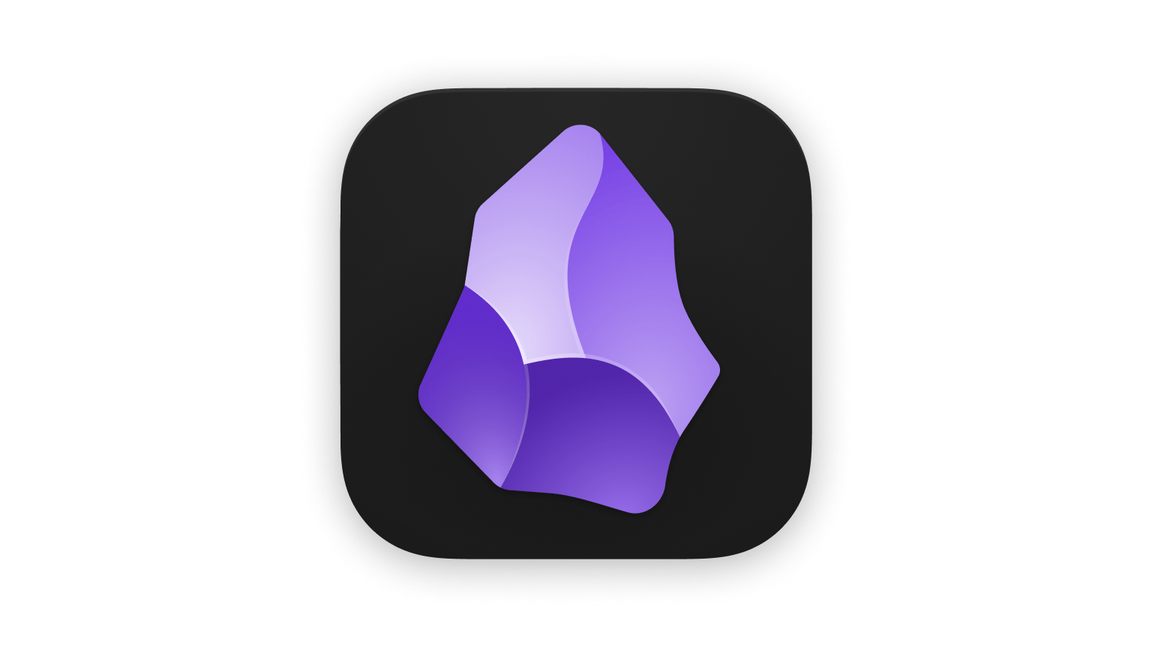
Free
Offline Mode
Great mobile
support
Customizable
Offline
Excalidraw
Local-first

Slide 7
New Setup Features
Markdown-Based Note-Taking – Uses plaintext Markdown files, allowing for easy formatting and compatibility with other Markdown editors.
Local Storage & Privacy – All notes are stored on your device, ensuring complete control over your data and offline access.
Linked Notes & Graph View – Create a network of interconnected notes and visualize their relationships with an interactive graph, enhancing your knowledge.
Plugins and Themes – Tailor Obsidian with a wide range of plugins and themes, adding functionality and personalizing its appearance.

Slide 8
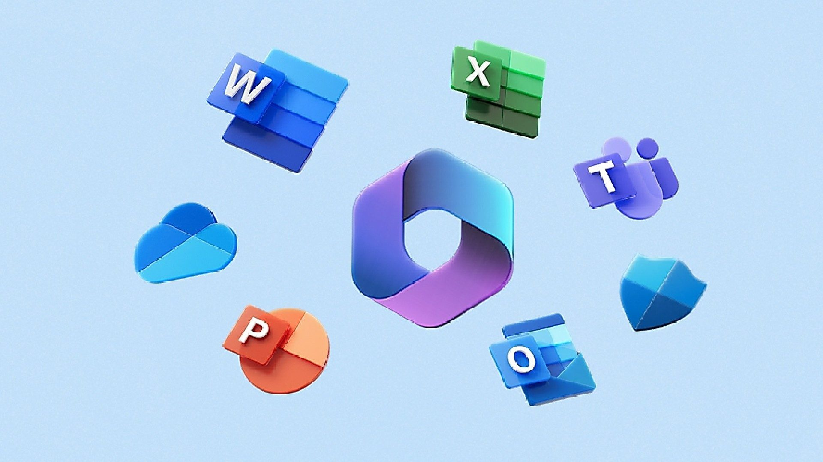
Notes:
We’ll still use Microsoft 365 (or Office 2024) for creating Word documents, PowerPoint presentations, and Excel spreadsheets. The files will be uploaded on Google Drive instead of Microsoft OneDrive.

Slide 9
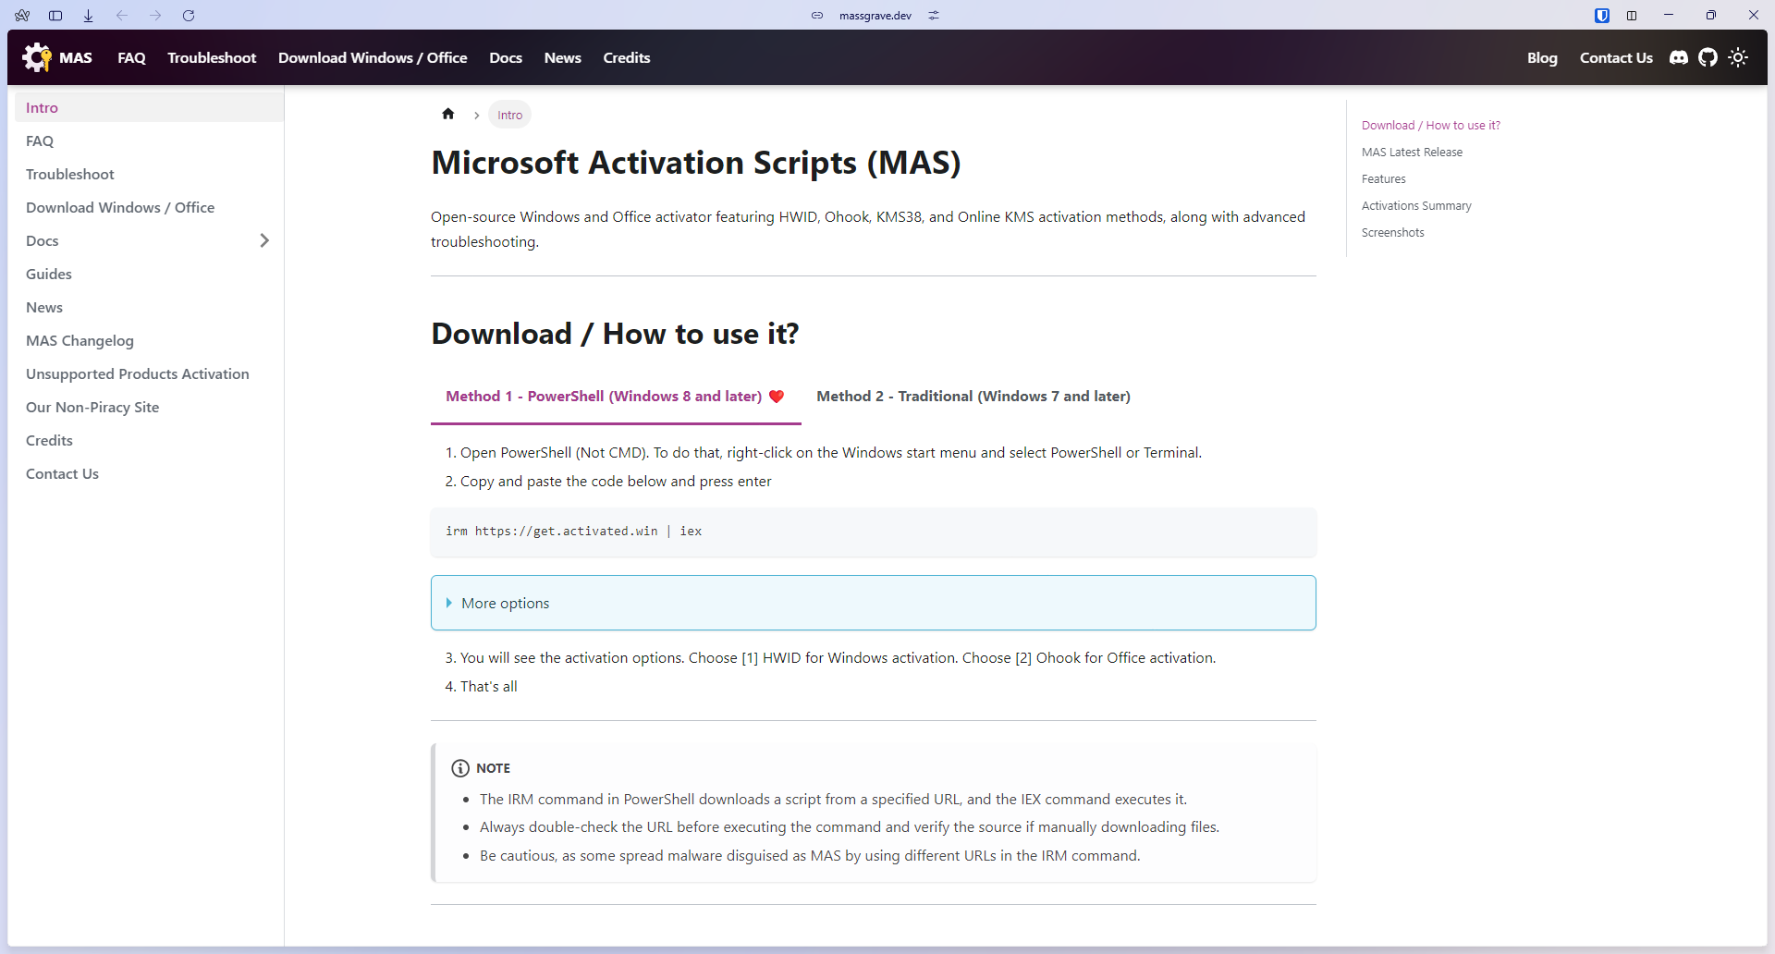

Slide 10
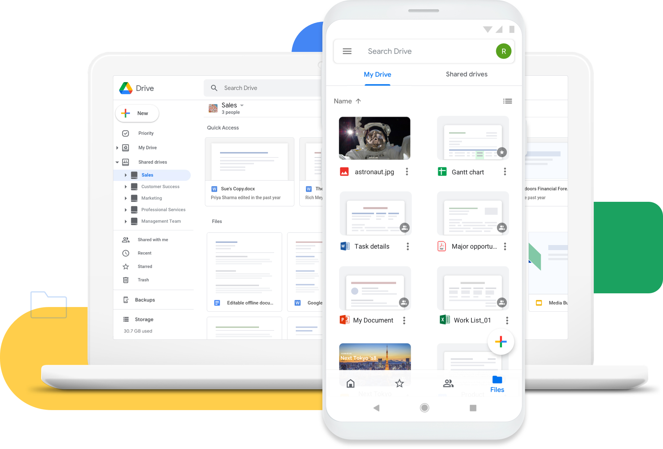

Slide 11
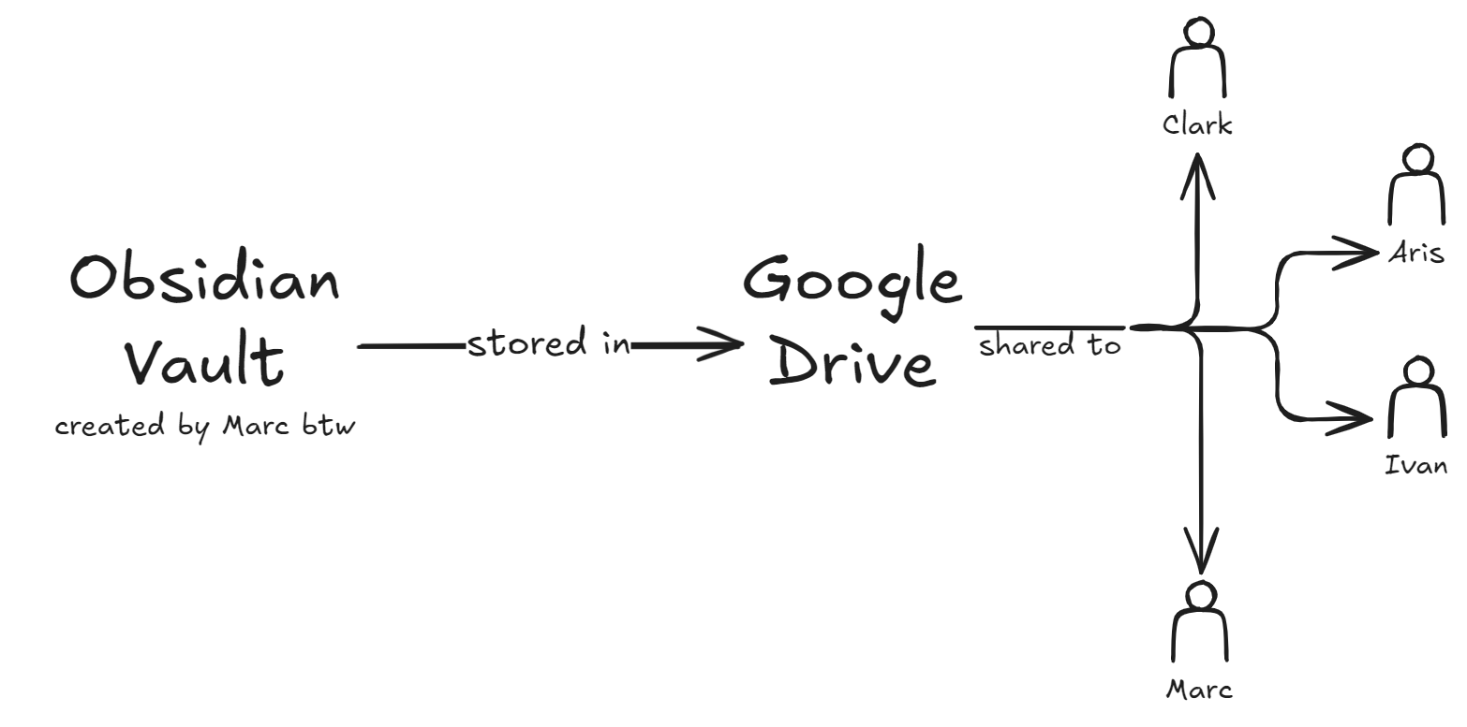

Slide 12
Installation Requirements
Google Drive Desktop
Obsidian
Office 2024

Slide 13
Obsidian Vault Navigation
Explore the never-ending journey of Marc always changing his productivity toolkit.
This f**ker is never going to get anything done because of this…

